Slide 1




Chapter 3: Basic Elements of Python 2

Slide 2
Lesson 3.1: Python Strings

Slide 3

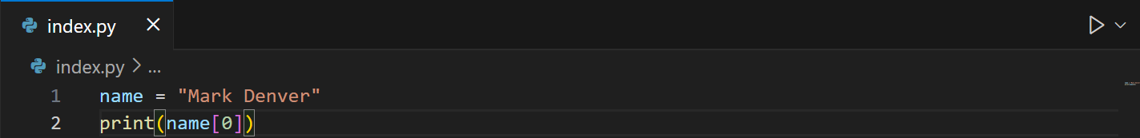
Python strings
Like many other popular programming languages, strings are arrays of bytes representing Unicode characters. However, it does not have a character data type, a single character is simply a string with a length of 1. Square brackets can be used to access elements of the string.
Example:

Slide 4
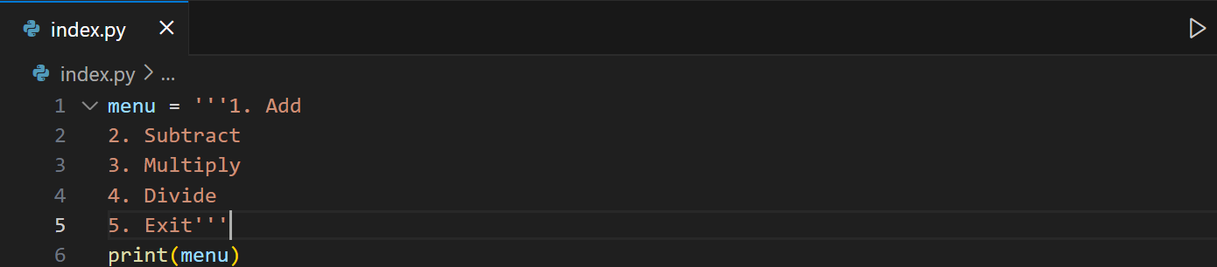
Python strings
We can also use triple quotes for multi-line text.
Example:

Slide 5
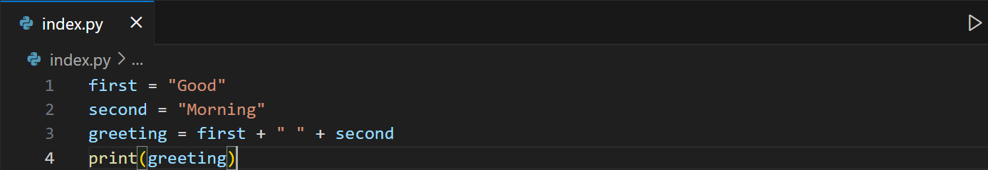
String Operations: Concatenation
You can join two or more strings using the + operator.
Example:
Now try to make the value of the 2nd variable to an integer and try to concatenate them to see what happens.

Slide 6
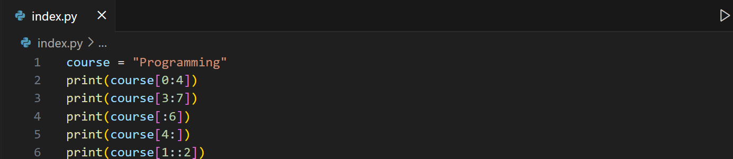
String Operations: Extracting substrings
You can extract a portion of a string using [start:end:step]. Python slices up to but not including the end index.
Example:

Slide 7
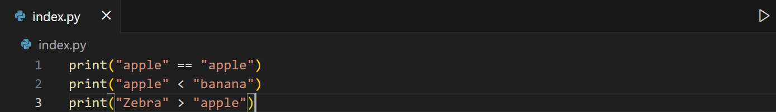
String Operations: Comparison
Strings can be compared alphabetically (lexicographically).
Example:

Slide 8
String Operations: Changing Case
Python provides methods to change string case.
Method | Definition
capitalize() | Converts the first character to upper case
casefold() & lower() | Converts string into lower case
swapcase() | Swaps cases, lower case becomes upper case and vice versa
title() | Converts the first character of each word to upper case
upper() | Converts a string into upper case

Slide 9
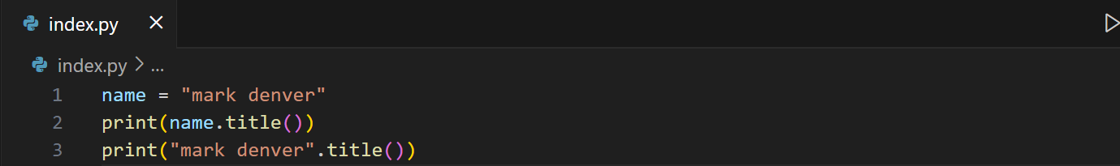
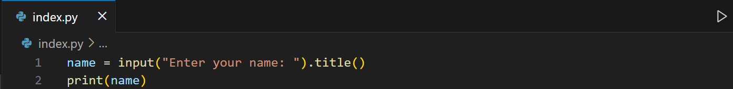
String Operations: Changing Case
Python provides methods to change string case.
Example use-case with print():
Example use-case with input():
Note: Some methods can be also applied during user input.

Slide 10
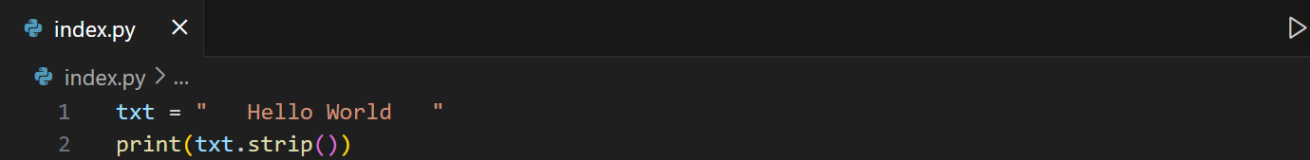
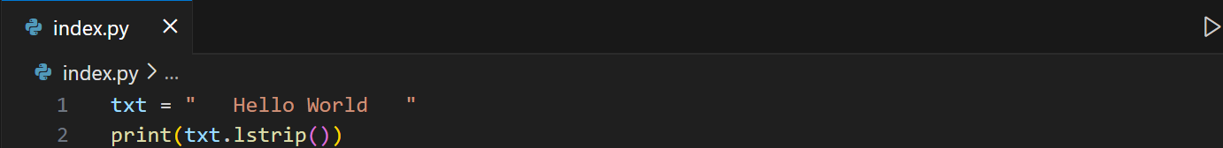
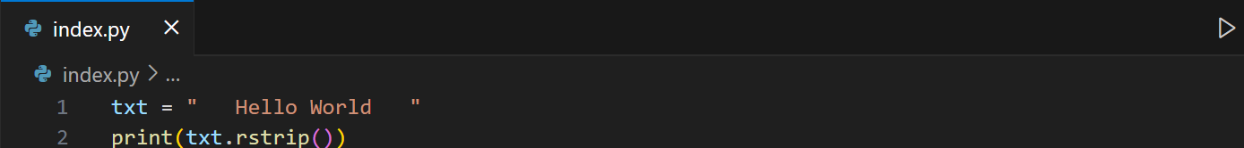
String Operations: Stripping Whitespace
Removes extra spaces at the beginning or end.
Example 1: Removing whitespaces on both ends.
Example 2: Removing whitespaces on the left
Example 3: Removing whitespaces on the right

Slide 11
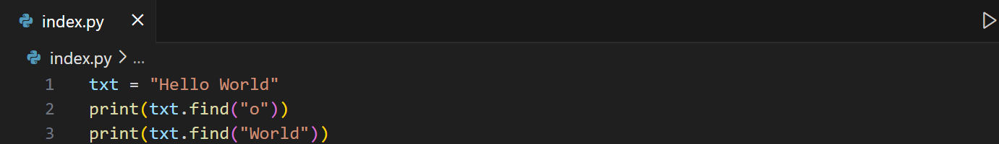
String Operations: Finding
We can use find() or index() to return the index of the specified value
Syntax: find(value) or index(value)
The rfind() and rindex() method finds the last occurrence of the specified value. rfind() returns -1 if the value is not found, while, rindex() raises an exception.

Slide 12
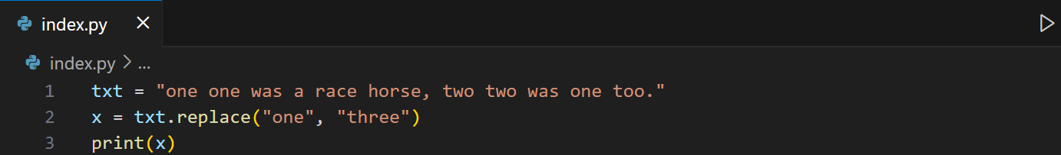
String Operations: Replacing
We can use replace() to return a string where a specified value is replaced with a specified value
Syntax: replace(oldvalue, newvalue, count) – count->int parameter is optional

Slide 13
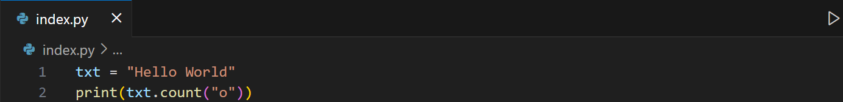
String Operations: Counting
We can use count() to return the number of times a specified value occurs.
Syntax: count(value, start, end) – start->int and end->int parameters are optional.

Slide 14
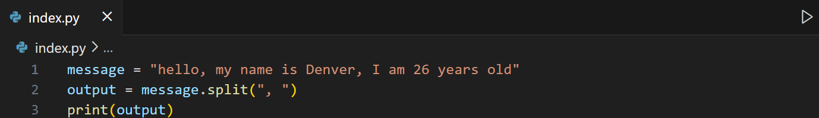
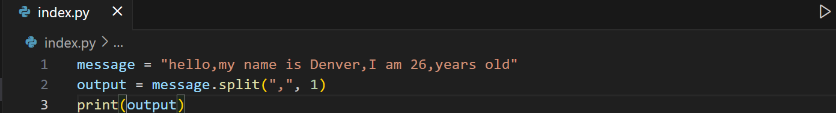
String Operations: Splitting strings
We can use split() breaks a string into a list.
Syntax: split(separator, maxsplit) – Both parameters are optional. By default any whitespace is a separator. maxsplit->int
When maxsplit is specified, the list will contain the specified number of elements plus one.

Slide 15
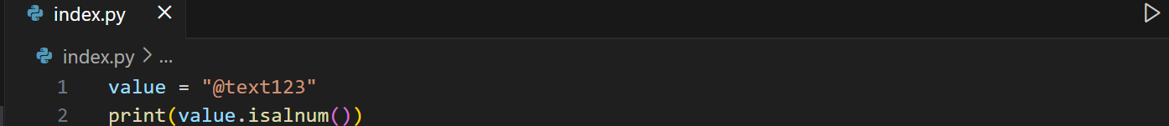
String Operations: Checking strings
Method | Definition
isalnum() | Returns True if all characters in the string are alphanumeric
isalpha() | Returns True if all characters in the string are in the alphabet
isnumeric() | Returns True if all characters in the string are numeric
isspace() | Returns True if all characters in the string are whitespaces

Slide 16
String Operations: String Length
To get the length of a string, use the len() function.
Example
The len() function returns the length of a string
a = "Hello, World!"
print(len(a))

Slide 17
Escape Character
To insert characters that are illegal in a string, use an escape character.
An escape character is a backslash \ followed by the character you want to insert.
An example of an illegal character is a double quote inside a string that is surrounded by double quotes:
Example:
txt = "We are the so-called "Vikings" from the north."

Slide 18
Learning Activity
Ask the user to enter their first name and last name.
Concatenate them into a single string and print:
Hello, <FirstName LastName>!
Display the first and last character of the name
Display the first three letters of the first name as nickname
Count how many times the letter "a" (case insensitive) appears in the full name.
Sample Output:
Enter your first name: Maria
Enter your last name: Santos
Hello, Maria Santos!
First character: M
Last character: s
Your nickname: Mar
Number of times 'a' appears in your full name: 3

Slide 19
Lesson 3.2: Python Numbers

Slide 20
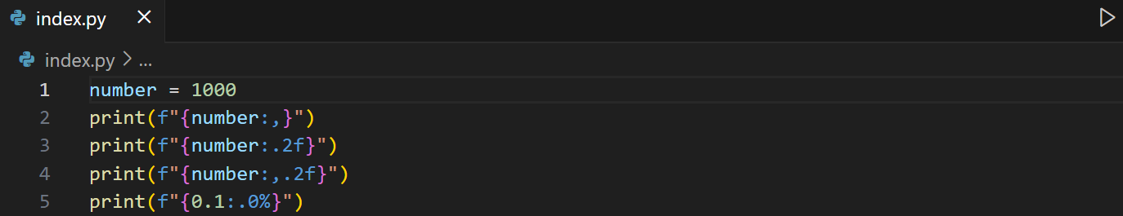
Number Operations: Formatting Types
Inside the placeholders you can add a formatting type to format the result:
format | Definition
:f | Fix point number format
:, | Use a comma as a thousand separator
:% | Percentage format

Slide 21
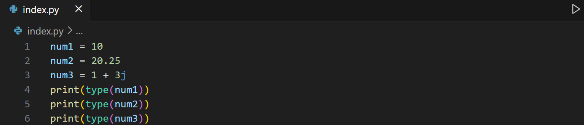
Number Operations: Determining Data Type
We use type() to determine the type of a variable or value.

Slide 22
Lesson 3.3: Python Conditions

Slide 23
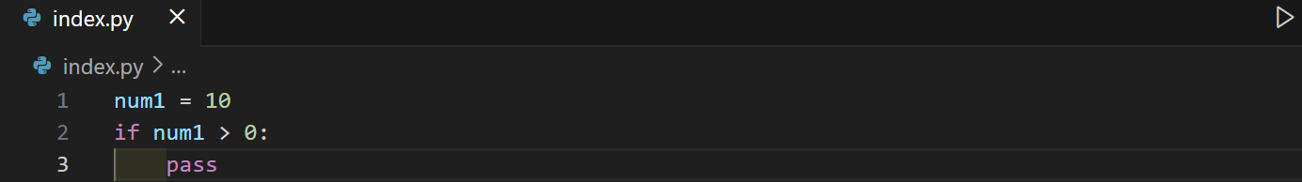
Basic if statement
To define scope of a statement, use an indentation.
Syntax:
if condition:
# code
Whenever writing a statement, make sure that it must have atleast 1 line of code, otherwise, an error will occur. Use pass statement.
Example:

Slide 24
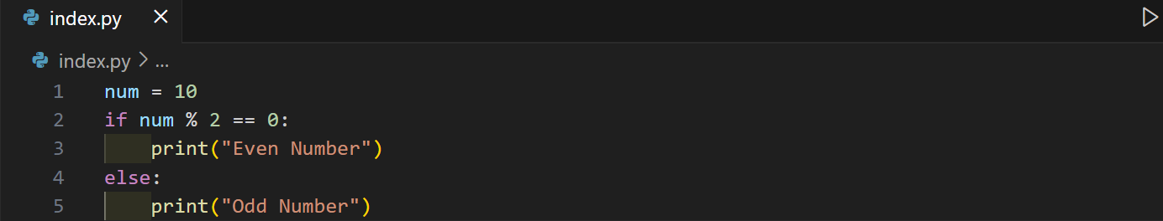
if-else statement
Syntax:
if condition:
# code
else:
# code
Example:

Slide 25
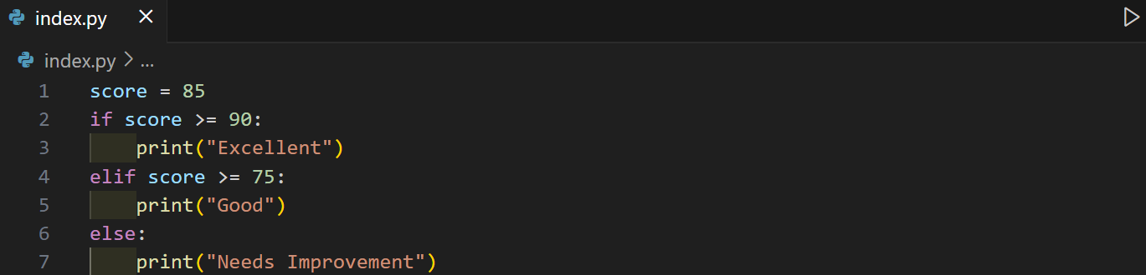
if-elif-else statement
Syntax:
if condition:
# code
elif condition:
# code
else:
# code
Example:

Slide 26
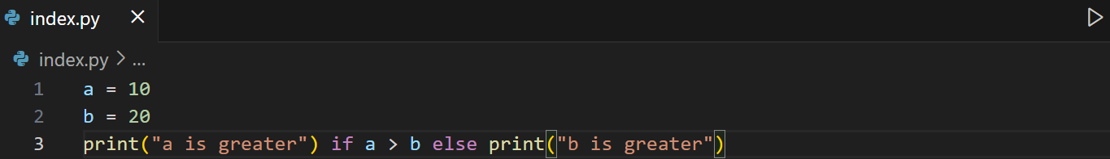
Shorthand if / Ternary Expression
Example:

Slide 27
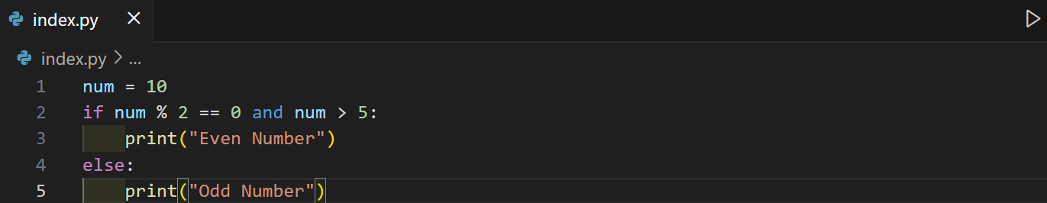
Multiple conditions
Syntax:
if condition and condition:
# code
else:
# code
Example:

Slide 28
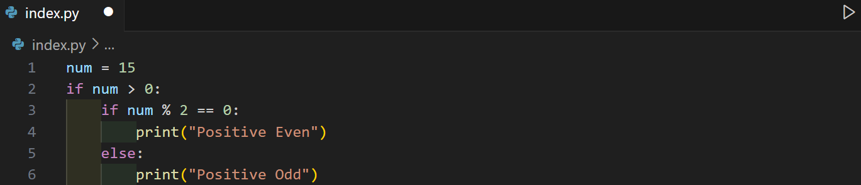
Nested if statements
Syntax:
if condition:
if condition:
# code
else:
# code
Example:

Slide 29
Learning Activity
Write a program that asks for a username and password. If they match predefined values (user = "admin", password = "1234"), print "Login successful", otherwise print "Access Denied".
Write a program that will check if user input is just whitespace or did not enter anything.

Slide 30
Python match statement
Syntax:
match variable:
case value1:
# code block
case value2:
# code block
case _:
# default case
match compares a variable against different patterns.
_ (underscore) works like a "default" or "else" case.

Slide 31
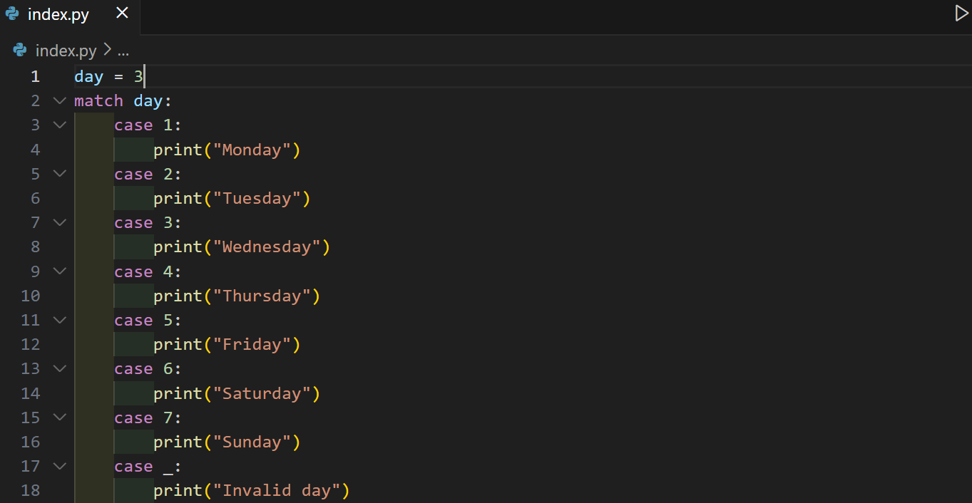
Python match statement
Example:

Slide 32
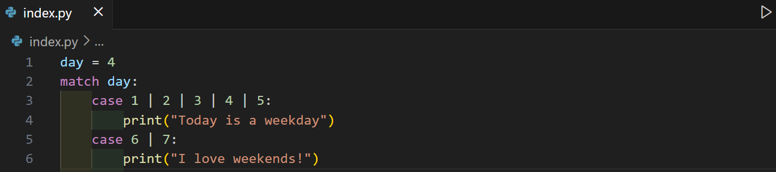
Using multiple values in one case
Use the pipe character | as an or operator in the case evaluation to check for more than one value match in one case.
Example:

Slide 33
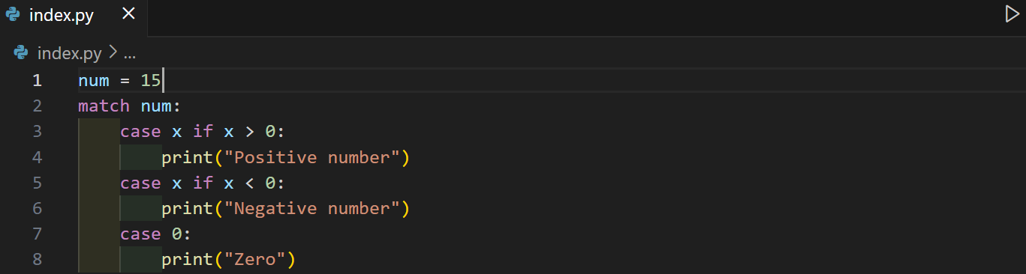
Using if statement
You can add conditions using if (called a guard). The use of undeclared variable in the case statement is only possible with the use of if statement. It will be called as pattern variable where it takes the value of what is being matched, in this case: num
Example:

Slide 34
Using if statement
You can add conditions using if (called a guard). The use of undeclared variable in the case statement is only possible with the use of if statement. It will be called as pattern variable where it takes the value of what is being matched, in this case: num
Example:

Slide 35
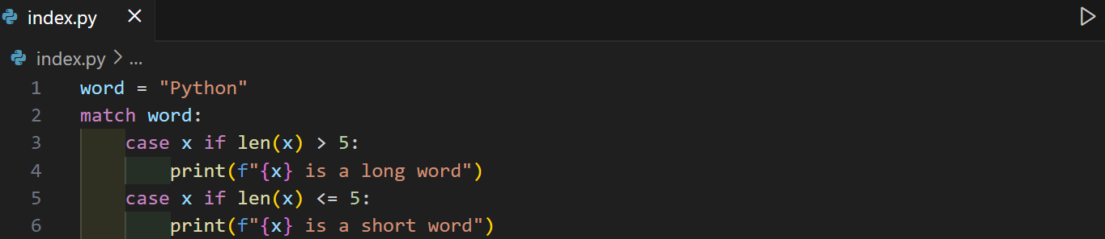
Using if statement
Example:

Slide 36
Learning Activity
Create a match-case program that asks the user to enter a shape (circle, square, triangle). Then:
  If circle, ask for radius and compute area.
  If square, ask for side and compute area.
  If triangle, ask for base and height and compute area.
  Otherwise, print "Invalid shape".

Slide 37
Lesson 3.4: Looping Statements

Slide 38
Looping statements: for loop
Loops are essential when dealing with repetitive tasks like printing sequences, processing lists, or handling user input until a condition is met. Python provides two main types of loops: for loop and while loop.
Syntax:
for variable in sequence:
# code

Slide 39
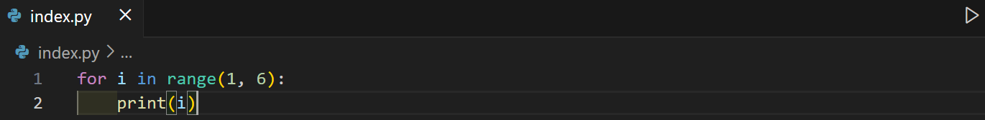
Looping statements: for loop -> range()
The range() method generates a sequence of numbers based on the given values.
The loop starts with i = 1, then i = 2, and so on until i = 5. Each time, print(i) runs.
range() syntax: range(start, end, step) – all parameters are integers. The end and step parameters are optional.
Example:
Note: If only value is provided, it will be the end parameter and the start takes 0 value by default.

Slide 40
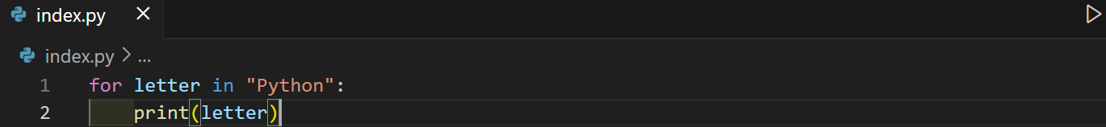
Looping statements: for loop -> strings
Each character of the string is taken one by one.
Example:

Slide 41
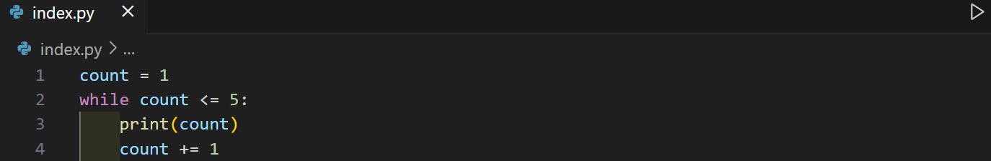
Looping statements: while loop
Repeats if the condition is true.
Syntax:
while condition:
# code to execute
Example:

Slide 42
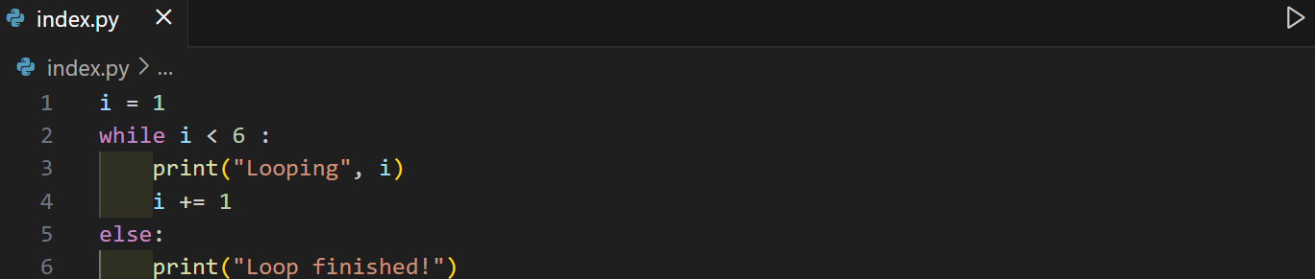
Looping statements: using else statement
After the loop finishes naturally, the else block executes. If the loop ended early with break, the else part would not run.
Example:

Slide 43
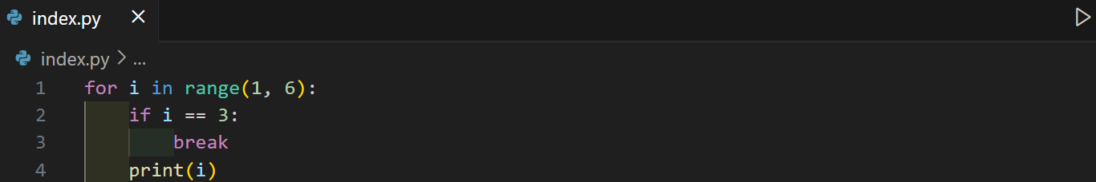
Looping statements: Control Statements
break -> exits the loop completely.
continue -> skips the current iteration and moves to the next.
pass -> does nothing (placeholder).
Example:

Slide 44
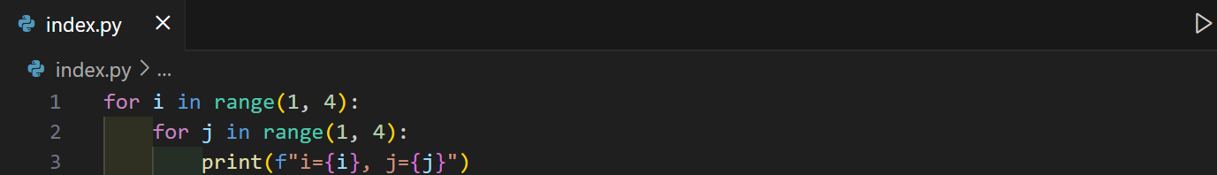
Looping statements: Nested Loops
A loop inside another loop.
Example:

Slide 45
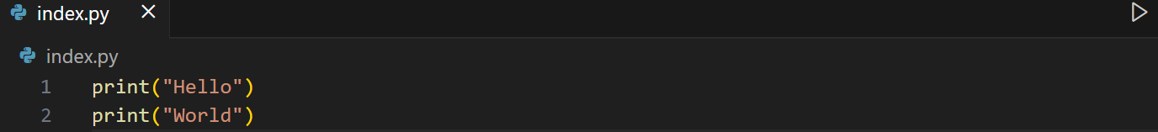
Looping statements: using end parameter
In print() function, the keyword argument end controls what is printed at the end of each call.
By default:
Notice each print() goes to a new line because end="\n" is the default.

Slide 46
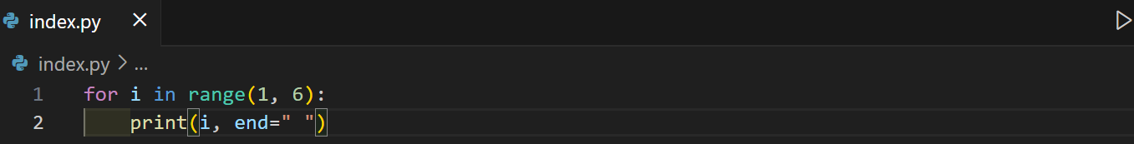
Looping statements: using end parameter
If we change end to " " (a space) or "" (nothing), we can print on the same line.
Example:
Note: You can put any character/string in end.

Slide 47
Learning Assessment
Write a program that prints the sum of all numbers from 1 to 100.
Display the Fibonacci sequence up to 10 terms.
Create a program that asks for a password and keeps prompting until the correct password is entered.
Write a program using nested loops to display the following pattern:
1
12
123
1234

